Slide 1
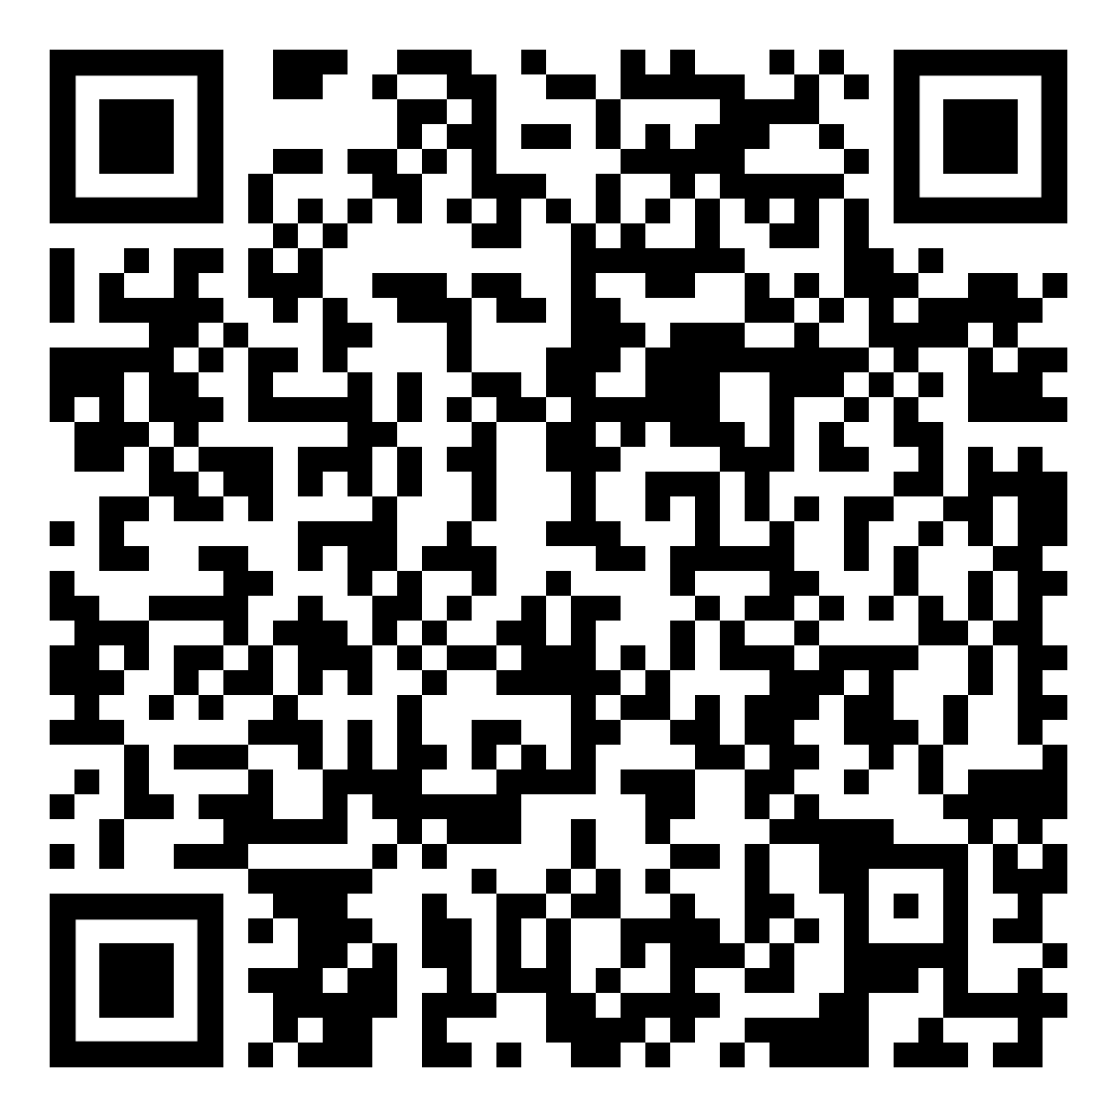
MINIMIZE research activities through prioritization, delay, replacement, or reduction
Can research be delayed until more is known about risk of human-to-bat transmission of SARS-CoV-2?
No
Yes
Can close human-to-bat contact and bat handling activities can be replaced with alternatives?
DELAY:
Assess in 3-6 months and/or
When new information or recommendations available
No
Research is essential and urgent
No alternatives are acceptable
Yes
Alternative methods include:
acoustic surveys
emergence counts
observational approaches
REPLACE:
Use alternative research activities
REDUCE: Implement reductions to minimize exposure, including:
reduce number of sites and bats
reduce size of research team
Proceed to ASSESS & PROTECT
Full recommendations @ https://tinyurl.com/mapforbats

Slide 2
ASSESS probability you are shedding SARS-CoV-2 and may expose bats
Are all research team members COVID-19 free? (e.g. negative test result and no known exposure within last 2 weeks)
Full recommendations @ https://tinyurl.com/mapforbats
Yes
Quarantine for 14 days
Self-monitor for symptoms
No
One or more team member is:
diagnosed with COVID
exhibiting symptoms
known exposure < 2 weeks
STOP! Return to MINIMIZE
DELAY, REPLACE, REDUCE
Did initial travel to get to your field sites have high risk of exposure?
No
No
Yes
High exposure travel, includes:
international air travel
long-distance ground travel
public transit
high contact risk with public
limited social distancing while traveling
Have you quarantined and self-monitored for symptoms for 14 days?
Can team monitor and avoid risk of exposure from local community?
Yes
No
Yes
Yes
Proceed to PROTECT:
PROTECT team by following public health policies
PROTECT bats by adopting practices that reduce bats’ exposure
Is there high local incidence of COVID 19 in the research area?
No
Continuously monitor local COVID-19 incidence

Slide 3
PROTECT bats by adopting practices that reduce bats’ exposure
Are you conducting research that involves close contact with bats (< 2m) or allows for aerosol build up?
Yes
Research involves:
Capture and handling of bats and/or
Work in enclosed settings with bats, e.g.:
subterranean surveys
trials in labs/flight cages
captive colonies
No
Research is not in enclosed settings and does not involve close contact with bats, e.g.:
acoustic surveys and monitoring
external emergence counts
PROTECT the BATS
Wear a face covering and do not blow on bats
Wear gloves and change/disinfect/clean regularly
Keep your distance when not handling
Practice hand hygiene
Avoid touching face
Disinfect/clean gear
Conduct research activities
Follow local health policies
Full recommendations @ https://tinyurl.com/mapforbats

